Slide 1
INFO 450 Final Project
Tinodaishe Mahlunge

Slide 2
Problem Statement
For my project I will be analyzing the most popular kinds of cereals and how healthy they actually are & what you may not exactly know about the real ingredients included in your favorite cereals.
Most cereals are full of unhealthy amounts of sodium, carbs, things that are commonly overlooked in even the most healthily perceived breakfast cereals can pose a health risk and analyzing such is beneficial; it’s good to know what you’re consuming.
Another brief purpose in this analysis is to observe which companies are more popular amongst consumers.

Slide 3
Problem Analyzing
In analyzing this dataset of cereals, I went deep into analysis of all things cereal, from the ingredients to the companies that make/sell all cereal.
Prior to research, I proposed that more popular companies such as Kellogg’s and General Mills will have a higher calorie/sodium intake due to the fact that they make cereals including Frosted Flake, Froot Loops, Trix, Lucky Charms, & Reeses Puffs.
Also I predict prior to analysis that customers may enjoy these companies more due to the fact that they are high in ingredients such as sugar, a common drive in attracting more purchases.
In the analysis I used a bar chart, heatmap/ correlation matrix, pie chart, skewed bar chart & 3 scatter plots to analyze various aspects of cereal ingredients and companies.

Slide 4
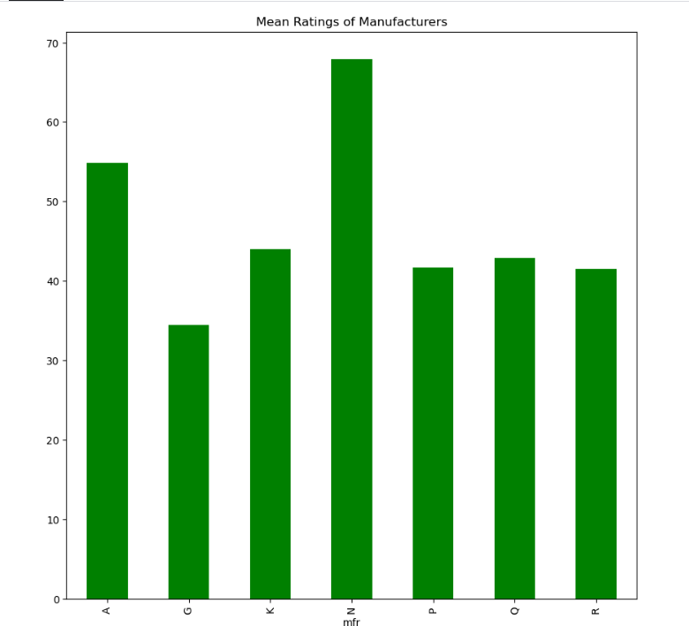
A = American Home Food Products, G = General Mills, K = Kelloggs, N = Nabisco, P = Post, Q = Quaker Oats, R = Ralston Purina
Nabisco and American Home Food Products are highest rated.

Slide 5
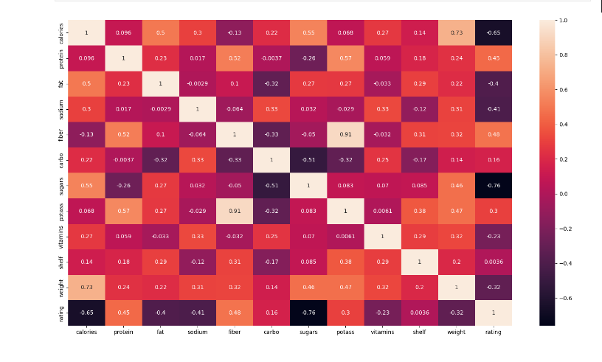
From the above correlation matrix, we notice two things:
Shelf is not correlated to rating. Which is to be plotted in the pie chart for these below. This variable is, in fact, a categorical variable (with values as 1,2 and 3 only). Including dummy variables later (in my code) will show if the Shelf variable is relevant in predicting cereal ratings.
Weight is highly correlated with other variables, especially calories. This makes sense, as more the ingredients, more the weight will be, and vice versa. This variable is creating unnecessary multi-collineairity in our model. This can be removed..

Slide 6
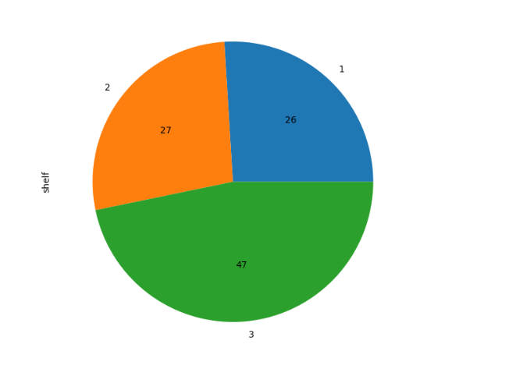
26 cereals are put on shelf 1, 27 on shelf 2, 47 on shelf 3.

Slide 7
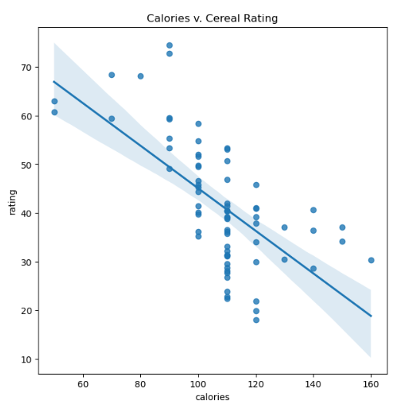
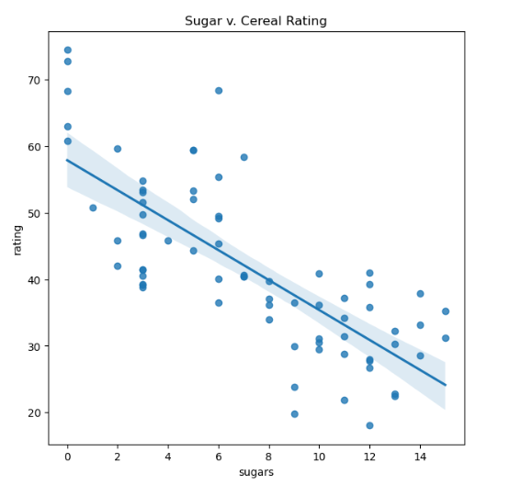
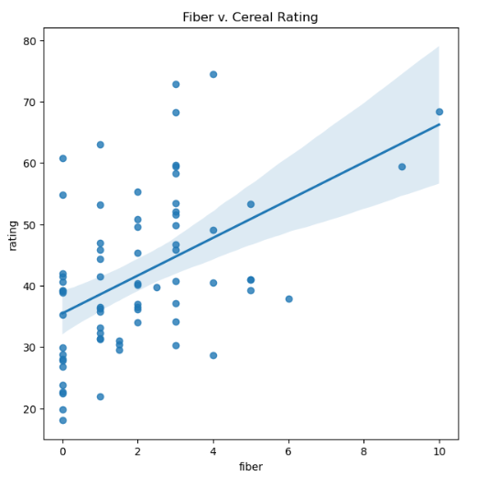
As seen from above, the rating falls on average as sugar amount increases in the cereal. This shows that consumers value the 'healthy' aspect of cereals and would ideally rate high those cereals that have minimum sugar.
Again, consumers value less and less calories in their cereal intake. And the trend is visibly negative between calories & rating.
There's a visible positive correlation between fiber and cereal rating. People like fiber-rich cereals.
NOTE: We removed the outlier before from fiber attribute that had the value of 14. Imagine how that would have distorted our best fit line!

Slide 8
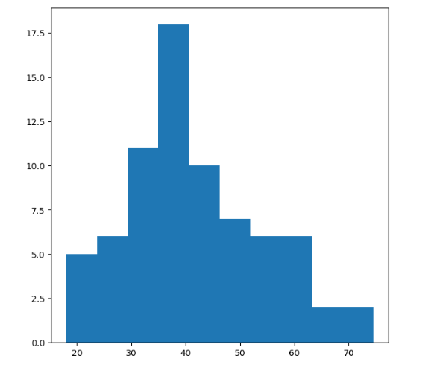
Distribution of Company Ratings
It is somewhat normal, but slightly skewed to the left.

Slide 9
Future Recommendations
In the future, I can recommend that cereal companies can prioritize creating more healthy breakfast alternatives, lacking in sugar and calories and more in fibers
This contradicts my theories of thinking that consumers would prefer more heavy intakes in sugar and artificial ingredients which seems to taste better overall.
I would suggest that this problem is to be revisited yearly in order to keep track of consumer favorites and what they prefer in terms of ingredients.
In the future, I would try to do better in getting regression models and groupbby data and thinking more into my predictions.

